Slide 1
Linux Kernel Development Week 2
工海四 b06501018 朱紹勳

Slide 2
 | Linux Kernel Dev 3rd | Understand Linux Kernel 3rd | Extra
Bottom Half of interrupt context | Chapter 8 | Chapter 4
System Call | Chapter 5 | Chapter 10
Process Management | Chapter 3 | Chapter 3

Slide 3
Interrupt Context

Slide 4
Top Half & Bottom Half
Like pipeline, to make handler deal with interrupt faster
Top half :
Receive and response to interrupt
Reset hardware
Bottom half :
Almost all the Interrupt handler part

Slide 5
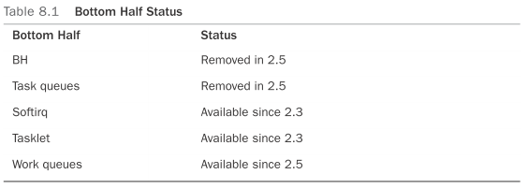
The environment of bottom half
First we have the “bottom half(BH)” mechanism
Static, simple , but , not allow concurrent, BOTTLENECK
Task queue
Still not flexible enough
Softirq
Static defined in compile time
Tasklet
dynamic defined in runtime implement by Softirq
Work queue

Slide 6
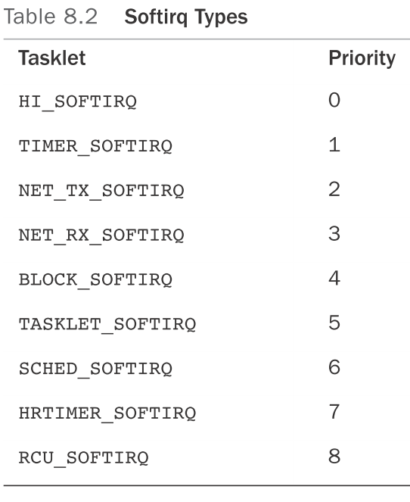
Softirq
Rarely used, only in
Defined in <linux/interrupt.h>
Implement:
Handler
Executing
Using
Assign index
Register handler open_softirq(NET_TX_SOFTIRQ, net_tx_action);
open_softirq(NET_RX_SOFTIRQ, net_rx_action);
Raise softirq raise_softirq(NET_TX_SOFTIRQ);
Notes:
When the kernel runs a softirq handler, it executes this action function with a pointer
to the corresponding softirq_action structure as its lone argument.

Slide 7
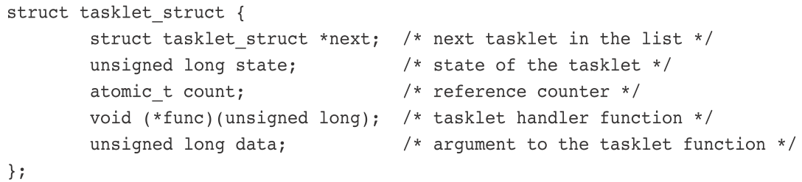
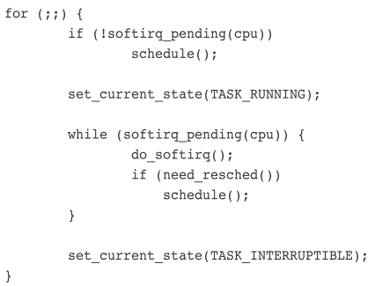
Tasklets
used frequently, simpler interface & locking rules
Usage
Declare DECLARE_TASKLET(my_tasklet, my_tasklet_handler, dev); tasklet_init(t, tasklet_handler, dev);
Write Tasklet Handler void tasklet_handler(unsigned long data);
Schedule tasklet_schedule(&my_tasklet); tasklet_disable(&my_tasklet); tasklet_enable(&my_tasklet);
ksoftirqd
A kernel thread to support a lot of tasklet & softirq : Scheduling
ksoftirqd use do_softirq() to deal with pending softirq call schedule() to enable more important process

Slide 8
Work Queues
Different mechanism, push the work to a kernel thread, context switch
Implement : workqueue_struct, worker thread
Usage
create task:
DECLARE_WORK(name, void (*func)(void *), void *data);
INIT_WORK(struct work_struct *work, void (*func)(void *), void *data)
work handling function : void
work_handler(void *data) // exec by kernel thread, run at process context
scheduling
schedule_work(&work);
schedule_delayed_work(&work, delay);
flushing
void flush_scheduled_work(void);
int cancel_delayed_work(struct work_struct *work);
create new workque
struct workqueue_struct *create_workqueue(const char *name);
int queue_work(struct workqueue_struct *wq, struct work_struct *work)
int queue_delayed_work(struct workqueue_struct *wq, struct work_struct *work, unsigned long delay)

Slide 9
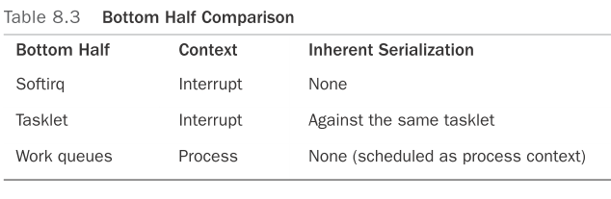
Which Bottom Half Should I Use?
Tasklet is a simpler form of Softirq
Softirq leak support of serializations
Workque use kernel thread.
1. If the program fully support thread, CAN use Softirq.
2. Prefer Tasklet to Softirq in general case.
3. If the task need to run in context switch(sleep), choose Workque.
Overhead: Workque > others (because of context switch)
Easy to use: Workque > tasklet > Softirq

Slide 10
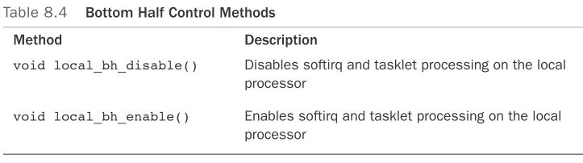
Locking & Disabling in Bottom Halves
Further discussion in synchronization chapter
Serialization between tasklets:
The same tasklet will not run concurrently, even on two different processors
Don’t have to worry about synchronization in tasklet
Workque need lock mechanism (because of context switch & SMP)
To control bottom-half process (Softirq & tasklet), call the follow func.
defined in <asm/softirq.h>
Workque works just like process context

Slide 11
System Call

Slide 12
System Call
A layer between user process and hardware
Make programming easier (API) - POSIX
improve system security : Access Right, Encapsulation
Other ways to enter Kernel : exception, external interrupt
API vs. Sys Call → A function definition / A request to kernel by trap trap : the software interrupt defined #interrupt 128 in X86
Trigger by int $0x80 instruction
Return of Sys Call:
usually (-) means error
or defined in errno.h ex : include/asm-i386/errno.h

Slide 13
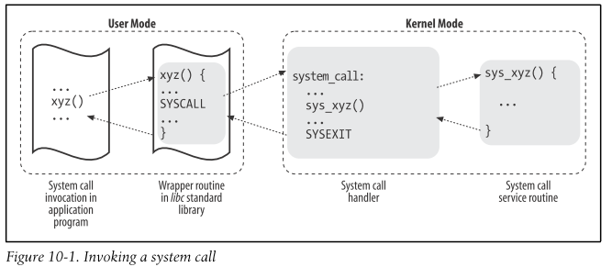
System Call - Handler & Service Routine
Routine
Save register to Kernel Mode Stack
→ C func() → System call handler(assembly) → System Call Service Routine
Exit from handler, Stack → register, Switch to User Mode
System Call Identification
We will pass system call number to help us, EAX register → Kernel
find #system call in dispatch table(store in an array), there are 289 in 2.6 ver
NR_syscalls macro 檢查 system call 是否合法
if so, call *sys_call_table(,%rax,8);
Parameter of func() : ebx, ecx, edx, esi, edi register in X86_32
Name of Service Routine : sys_xyz() ← xyz()

Slide 14
System Call - Ways to invoke Sys Call
There are two ways to invoke and exit Sys Call:
invoke : 用 int $0x80 assembly (old) exit : 用 iret assembly (old)
invoke : 用 sysenter assembly
exit : 用 sysexit assembly Appendix ?

Slide 15
Passing & Verifying Parameters
(1). Exceed 32bit (because of register) (2). 5 parameters
More than 5 : A register will point to a memory area in the process address space that contains the parameter values.
An useful & efficient examination process (return –EFAULT when error):
Verify the linear address is lower than PAGE_OFFSET
(i.e., that it doesn’t fall within the range of interval addresses reserved to the kernel).
Checking until the last possible moment
access_ok(); two parameters: addr, size, addr+size < (1) 2^32-1 (2)thread_info addr_limit.seg store
Check pointer legal access, Check if in user space…
<linux/capability.h>

Slide 16
Binding A System Call
Register to an official system call:
1. Add an entry to the end of the system call table (for every achitecture)
2. Define system call number in <asm/unistd.h>
Compile syscall to kernel image(not module)
put system call into relevant file under kernel/

Slide 17
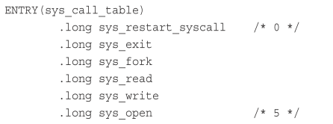

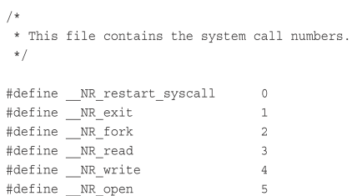
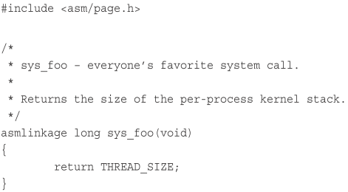
Summary : Create System Call
Assume a system call “foo”
1. Add .long sys_foo to the end of the entry.s file (the order indicate the syscall number)
Add syscall number (ex: #define __NR_foo 338 ) to <asm/unist.h>
3. Put code under kernel/sys.c file

Slide 18
Access system call from user space
Usually, the system call is provide from C lib
Linux provide a macro, so that we can access without glibc
General form of system call:
long open(const char *filename, int flags, int mode)
Linux Macro form:
#define __NR_open 5 // The system call number of open is 5
_syscall3(long, open, const char *, filename, int, flags, int, mode)
// The parameters:
1. The system call return type
2. The system call name
3. The type and name of system call parameters

Slide 19
Why Not to Implement a System Call
Pro of creating new system call:
easy and efficient under linux
Con of system call:
need extra syscall number
no modification
overkill
Alternative Solutions:
Implement a device node and read() and write() to it. Use ioctl() to manipulate specific settings or retrieve specific information.
Use file descriptors to represent interfaces, such as semaphores, and manipulate.
Add the information as a file to the appropriate location in sysfs.

Slide 20
Process Management

Slide 21
1 Intro of Process
2 Process Descriptor & Task Structure
3 Process Switch
4 Process Creation
5 Thread
6 Process Termination

Slide 22
Intro of Process
is a running program
need other resource, ex : kernel data, state, MM, data section…
fork() // clone()
exec() //
wait() //
waitpid() //

Slide 23
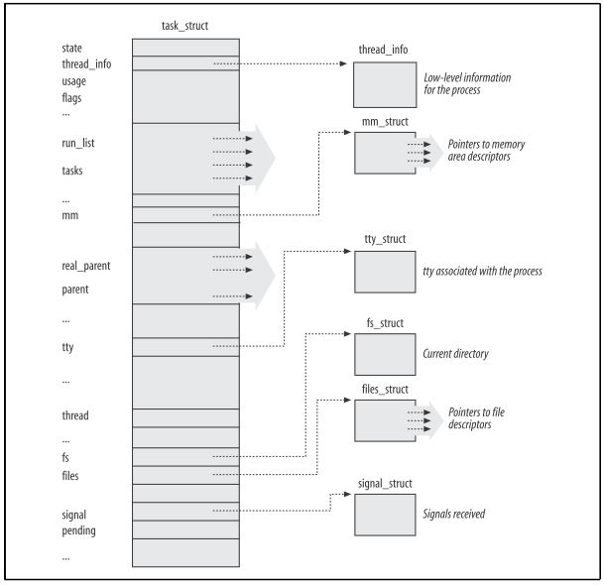
Process Descriptor & Task Structure
In type of struct task_struct
Item of doubly linked list - called “task list”
Defined in <linux/sched.h>
task_struct is huge, 17kb in x86 arch

Slide 24
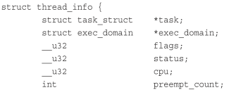

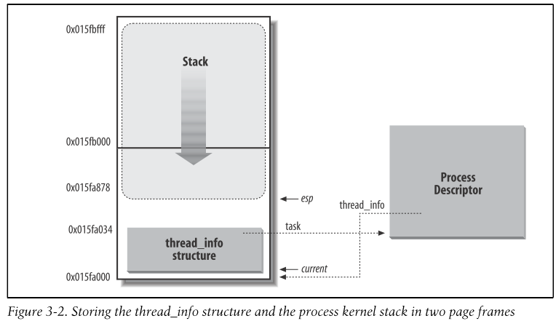

Allocation, Storage of Process Descriptor
struct thread_info is defined on x86 in <asm/thread_info.h>
struct task_struct stored at the end of the kernel stack of each process - to use less register, stack pointer is enough
Use unique PID(pid_t : int) to identify processes
max as 32,768 (or modify in /proc/sys/kernel/pid_max)
In x86, offset of thread info is 8192 (13 LSB)
current_thread_info()->task;
getpid(); // tgid vs pid

Slide 25
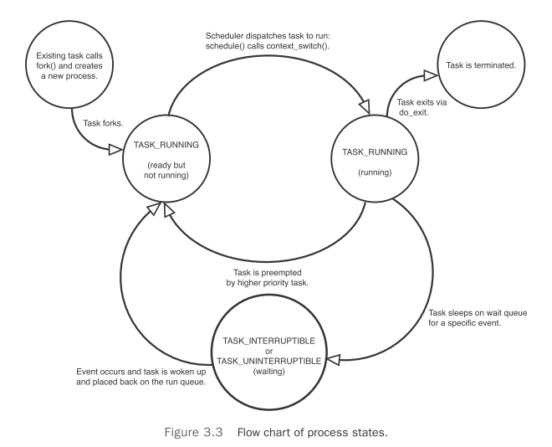
Process State
TASK_RUNNING: Runnable, running, waiting for run TASK_INTERRUPTIBLE: The process is sleeping (blocked) TASK_UNINTERRUPTIBLE: it does not wake up and become runnable if it receives a signal TASK_STOPPED: This occurs if the task receives the SIGSTOP , SIGTSTP , SIGTTIN , or SIGTTOU signal TASK_TRACED:
In debugger, ptrace() by another process
-- EXIT_ZOMBIE: process terminate before parent call waitpid() EXIT_DEAD: The final state before delete, after parent issued waitpid()
p->state = task_running; kernel: set_task_state, set_current_state

Slide 26
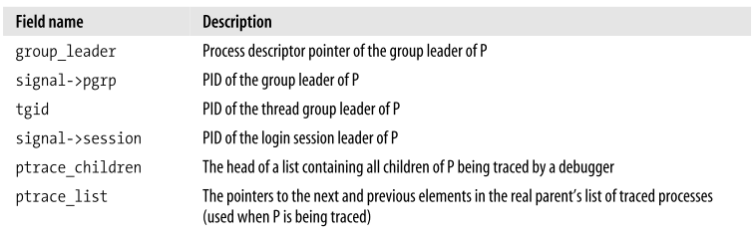
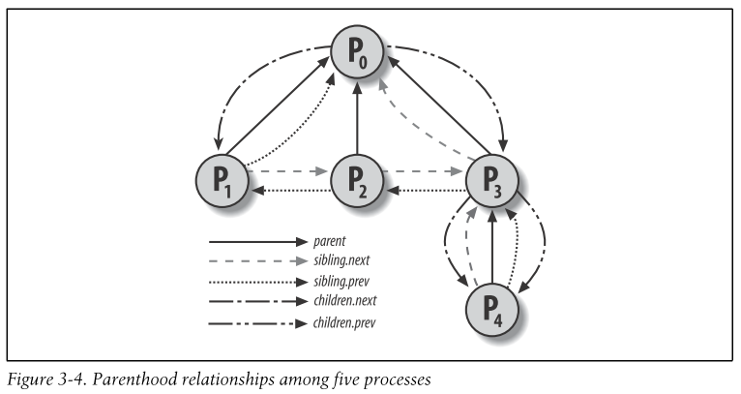
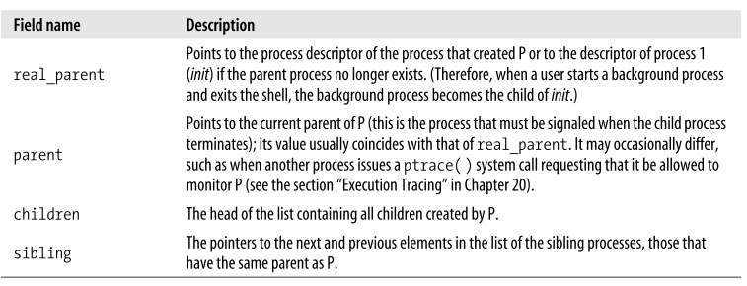
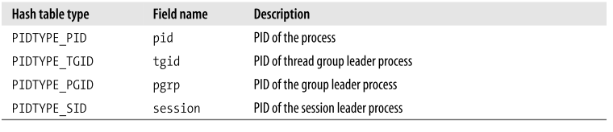
Process Relationship
PID 0 is called swapper, use for scheduling
All process are the child of init (PID = 1)

Slide 27
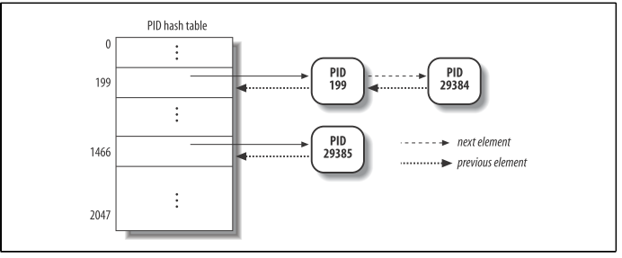
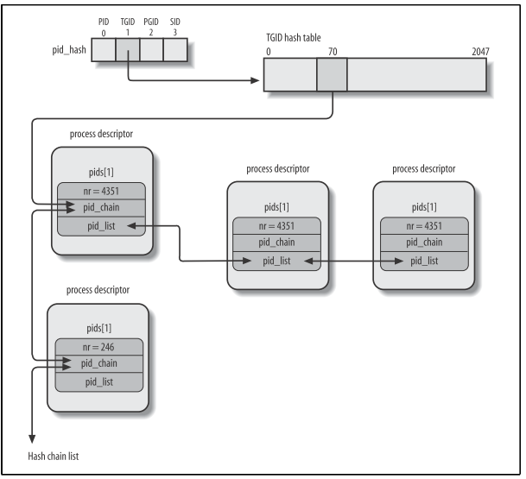
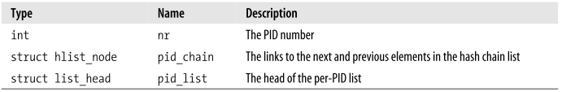
PIDhash
Hash table with 2048 indexes + chaining
struct of pid:
do_each_task_pid(nr, type, task)
while_each_task_pid(nr, type, task)
find_task_by_pid_type(type, nr)
find_task_by_pid(nr)
attach_pid(task, type, nr)
detach_pid(task, type) next_thread(task)

Slide 28
Process Creation
fork() & exec()
fork(copy) a current process
only difference is pid & some resource
Copy-on-Write
Share same process address space
When there is modify request, duplicate the parent content
very important optimization
Loads a new into the address space then execute

Slide 29
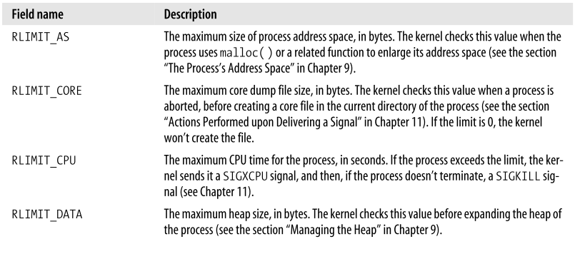
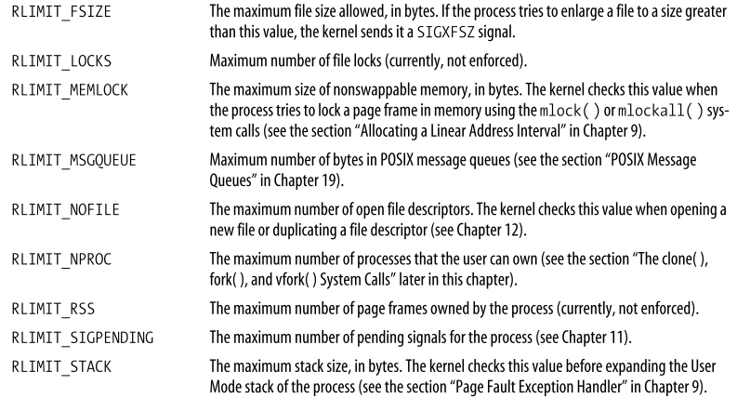
Process Resource Limitation

Slide 30
fork() vfork()
do_fork() // defined in kernel/fork.c
copy_process()
dup_task_struct() // create a kernel stack for new process
Check not exceed the resource limits
Reset some of the item in process descriptor
child’s state is set to TASK_UNINTERRUPTIBLE
Calls copy_flags() to update the flags member of the task_struct.
alloc_pid
return

